Slide 1
GDP Group 18
Unmanned Aircraft Camera Module
Notes:
Michael Start
Welcome

Slide 2
The Next 20 Minutes
Problem
Specification and Progress Overview
Breakdown of progress
Project management
Demo
Questions
Notes:
Michael
Describe our project: problem, specification, etc
How we’ve managed the project so far
Progress
Future plans

Slide 3
Problem
Notes:
Michael

Slide 4
Problem
Currently, an autopiloted UAV may take pictures while it is in the air
On many UAV systems the aircraft must land before images can be downloaded and viewed
These images could be inadequate
Wireless transmission of images preferred
Notes:
Michael

Slide 5
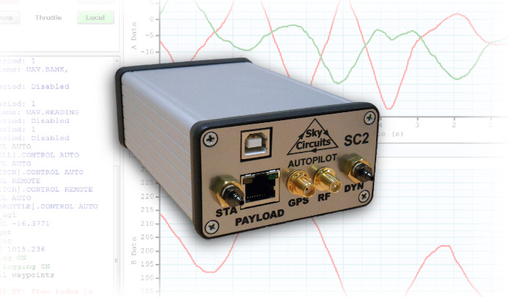
SkyCircuits Autopilot (SC2)
http://www.skycircuits.com/
Notes:
Michael

Slide 6
Specification & Progress Overview
Notes:
John

Slide 7
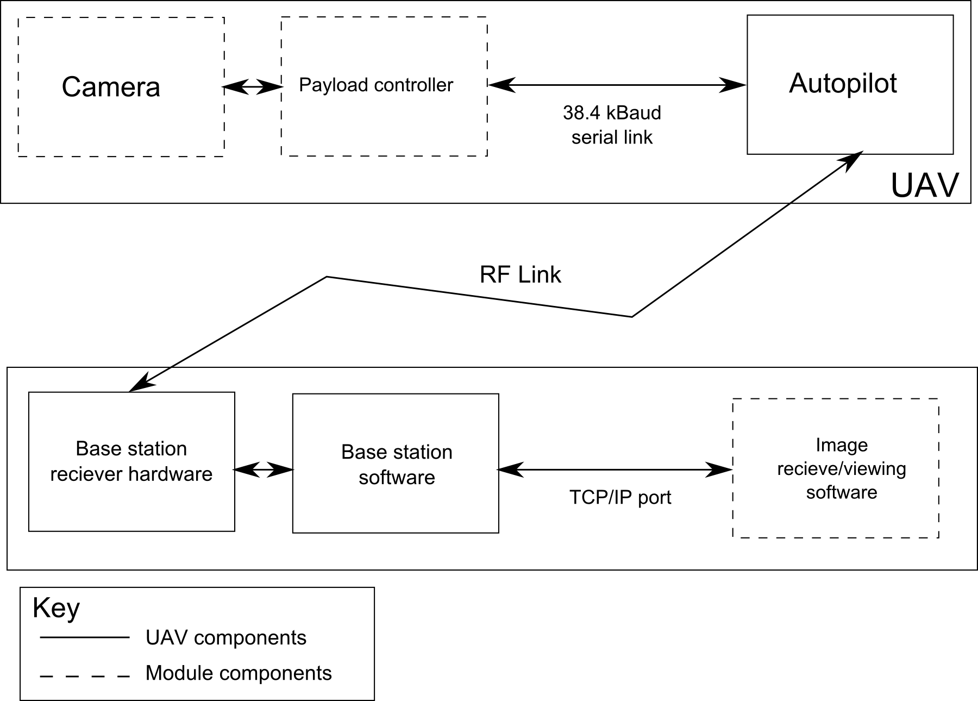
Specification
Notes:
John“To design, build and test an electronic module capable of capturing still images from an unmanned aerial vehicle (UAV) and transmitting the images to a base station. The module must use the UAV autopilot’s low-bandwidth RS485 serial link (38.4 kBaud). A program must be written to interface with the base station software over a TCP/IP link, allowing image data to be received and displayed to the user. The electronic module will be constructed using strip-boards and will later be implemented on PCB if time is available.

Slide 8
Spec: High Priority
Prompt (from base station) to capture and download image
Progressive Image encoding/decoding
Minimise download time (less than 3 minutes)
Notes:
John

Slide 9

Spec: High Priority
Prompt (from base station) to capture and download image
GUI under construction
Progressive Image encoding/decoding
Minimise download time (less than 3 minutes)
Approximately 10 seconds
Notes:
John

Slide 10
Spec: Medium Priority
Module weight < 250g
Image resolution: 640 x 480
Cancel image download whilst downloading
Notes:
John

Slide 11
Spec: Medium Priority
Module weight < 250g
##PUT IN MEASUREMENT##
Image resolution: 640 x 480
Cancel image download whilst downloading
Notes:
John

Slide 12
Spec: Low Priority
Resend an image if corrupted
Interrupt download of image, save incomplete image
Select resolution of image
Display progress indicator of download
(User defined) Automatic image capture
Colour images (select between colour / BW)
Notes:
John

Slide 13
Spec: Low Priority
Resend an image if corrupted
Interrupt download of image, save incomplete image
Select resolution of image
Display progress indicator of download
(User defined) Automatic image capture
Colour images (select between colour / BW)
Notes:
John

Slide 14
Spec: Deliverables
Hardware: Constructed camera module
Software: Firmware for module, Software for base station
Documentation: Technical and User Documentation
Public Repository: Open source, publically accessible repository, includes all the above
Notes:
John

Slide 15
Spec: Deliverables
Hardware: Constructed camera module
PCB
Software: Firmware for module, Software for base station
Documentation: Technical and User Documentation (WIP)
Public Repository: Open source, publically accessible repository, includes all the above.
https://github.com/andybusse/uavcamera
Notes:
John

Slide 16
Breakdown of Progress
Notes:
Andy

Slide 17
System Block Diagram
Notes:
andy

Slide 18
System Block Diagram
Notes:
andy

Slide 19
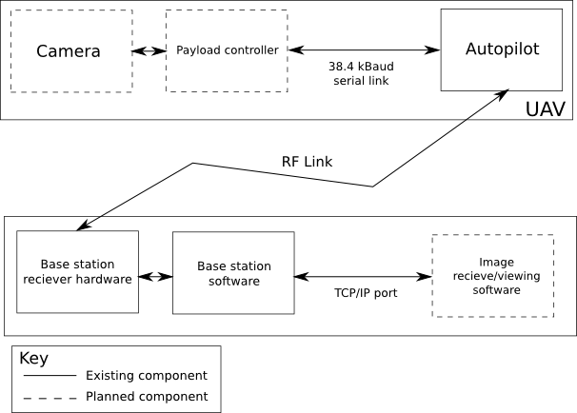
Breakdown of Progress: UAV Payload
Camera Module Communication
Image Encoding/Transmission
Basic Raw Encoding (JPEG)
Custom (compressed) encoding
Payload Module Construction
Notes:
andy

Slide 20


Breakdown of Progress: UAV Payload
Camera Module Communication
Image Encoding/Transmission
Basic Raw Encoding (JPEG)
Custom (compressed) encoding
Payload Module Construction
Notes:
andy

Slide 21
Camera Communication
Serial at 115200 baud
JPEG images at:
80 x 64
168 x 128
320 x 240
640 x 480
SD card used as storage

Slide 22
Image Encoding/Transmission
Autopilot ensures error free transmission
But does not ensure reliable transmission
Used packet structure
Each packet numbered
Variable size
GS can detect missing packets and ask for resend
Autopilot problems

Slide 23
Payload Module Construction
Breadboard and Stripboard prototypes
PCB design:
<insert image here>

Slide 24
Breakdown of Tasks: Base Station
TCP/IP Base Station Communications
Receive Image (JPEG)
Custom decoding
User Interface
Notes:
Andy

Slide 25
System Block Diagram
Notes:
andy

Slide 26
System Block Diagram
Notes:
andy

Slide 27
Breakdown of Tasks: Base Station
TCP/IP Base Station Communications
Receive Image (JPEG)
Custom decoding
User Interface
Notes:
Andy

Slide 28
Ground Station <-> Payload Communication

Slide 29
Ground Station <-> Payload Communication
Autopilot -> Payload comms: Message sending
Autopilot
Message
Payload
Ground Station

Slide 30
Ground Station <-> Payload Communication
Payload -> Autopilot comms: Shared memory
Autopilot
Ground Station
Shared memory
Payload

Slide 31
TCP/IP Basestation Comms
SkyCircuits ground control software exposes two ports: Data stream and Console
Ground Station
Console Port
Data Port

Slide 32
Ground Station <-> Payload Communication
Autopilot -> Payload comms: Message sending
Autopilot
Message
Payload
Ground Station

Slide 33
Ground Station <-> Payload Communication
Autopilot -> Payload comms: Message sending
Autopilot
Message
Payload
Ground Station
Our GUI
Console Port

Slide 34
Ground Station <-> Payload Communication
Payload -> Autopilot comms: Shared memory
Autopilot
Ground Station
Shared memory
Payload

Slide 35
Ground Station <-> Payload Communication
Payload -> Autopilot comms: Shared memory
Our GUI
Autopilot
Ground Station
Shared memory
Payload
Data Port

Slide 36
GUI
<screen shots>

Slide 37
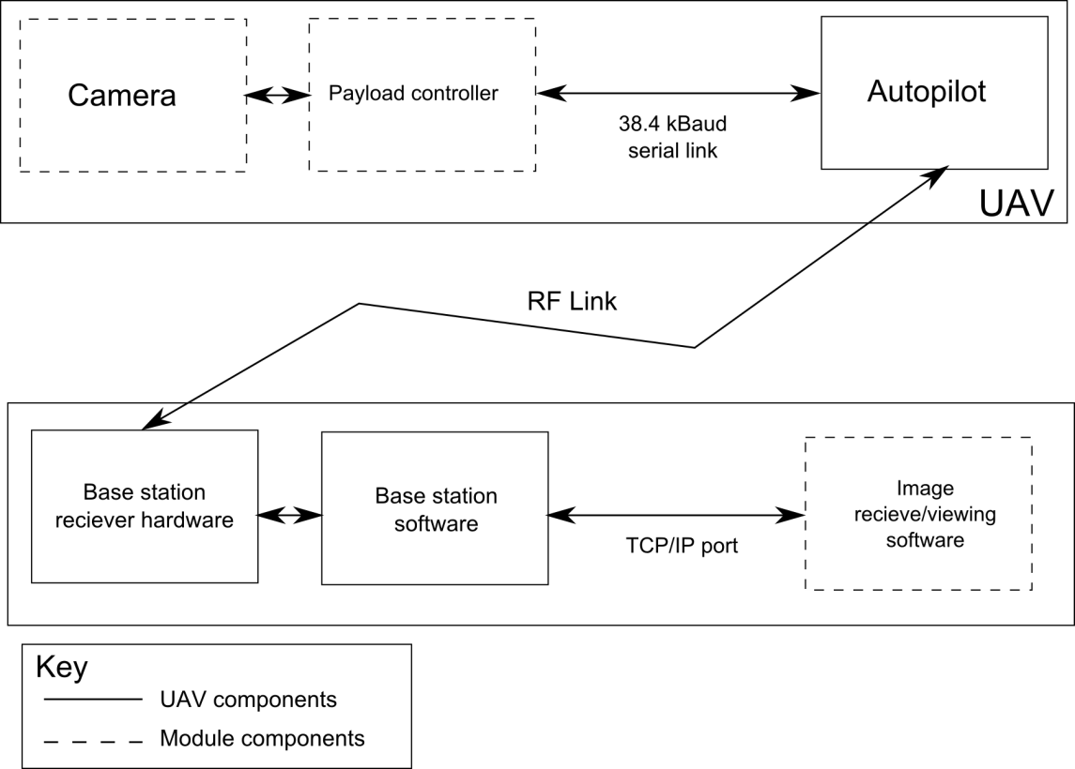
Breakdown of Tasks: Complete System
Background Research
UAV module / Base station Integration
Whole System Testing
Delicious Report Writing
Notes:
Andy

Slide 38
Breakdown of Tasks: Complete System
Background Research
UAV module / Base station Integration
Whole System Testing
Delicious Report Writing (WIP)
Notes:
Andy

Slide 39
Project Management
Notes:
Mitch:
Manage the human resources available and how best to utilise them.
Pre-emptive steps to take care of problems that might arise: always know what we’re doing
Manage time resource and measure the progress of the project, so we can adapt quickly if behind.

Slide 40
Recap – Last Seminar
Skills Audit
Risk management
Project plan, breakdown and progress

Slide 41
Project Management: Contingencies + Risk Management
Risk | Likelihood (1: Low, 5: High) | Impact (1: Low, 5: High) | Action
Faulty Components | 4 | 4 | Order spares where feasible. Source new/replace faulty components at high speed otherwise.
Team member becoming unavailable | 2 | 4 | At least two people on each task. Reallocating people to different tasks as required
Team member facing difficulties | 5 | 2 | At least two people per task. Good team communication. Prioritise necessary tasks first.
Notes:
Mitch
Why? Problems will arise. Need an appropriate plan for any problem that may occur as to not waste any time resource.
FC:
L4: experience with providers, general short circuits, loss, etc. (many factors)
I4: Project hardware dependent. Very real and serious problem.
Very time consuming problem (delivery, many other parts depend on this).
Team:
L2: Southampton is a safe place. Members take care of themselves.
I4: Each person is 20% of primary resource (needed to get things done)
All tasks can be done by different people, so catching up is easy.
Difficulties:
L5: Very challenging project ranging from hardware to software difficulties.
I2: Expected. Does not directly slow down progress.
Teamwork is more efficient than lone work

Slide 42
Obstacles
Faulty Components
Camera was faulty
Bug in Autopilot code
Risk Assessment Action: Order spares where feasible. Source new/replace faulty components at high speed otherwise.
Actual Action:
Camera - Ordered new (expensive) camera, modified project plan to fit around delay.
Autopilot – Extensive debugging alongside supplier of autopilot

Slide 43
Project Management: Contingencies + Risk Management
Risk | Likelihood (1: Low, 5: High) | Impact (1: Low, 5: High) | Action
Faulty Components | 4 | 4 | Order spares where feasible. Source new/replace faulty components at high speed otherwise.
Team member becoming unavailable | 2 | 4 | At least two people on each task. Reallocating people to different tasks as required
Team member facing difficulties | 5 | 2 | At least two people per task. Good team communication. Prioritise necessary tasks first.
Notes:
Mitch
Why? Problems will arise. Need an appropriate plan for any problem that may occur as to not waste any time resource.
FC:
L4: experience with providers, general short circuits, loss, etc. (many factors)
I4: Project hardware dependent. Very real and serious problem.
Very time consuming problem (delivery, many other parts depend on this).
Team:
L2: Southampton is a safe place. Members take care of themselves.
I4: Each person is 20% of primary resource (needed to get things done)
All tasks can be done by different people, so catching up is easy.
Difficulties:
L5: Very challenging project ranging from hardware to software difficulties.
I2: Expected. Does not directly slow down progress.
Teamwork is more efficient than lone work

Slide 44
Project Management: Contingencies + Risk Management
Risk | Likelihood (1: Low, 5: High) | Impact (1: Low, 5: High) | Action
Task overrunning | 4 | 3 | Plenty of redundancy planned into Gantt Chart. Reallocation of resources when necessary. Good team communication.
Loss of files/source code | 1 | 5 | Proper use of source control. Back ups.
Loss of access to facilities | 1 | 4 | Work from home laboratory. Buy missing components if necessary.
Notes:
Mitch
Risk
L4: Impossible to always know what other is doing without consistent, non-stop (unrealistic) communication.
I3: Results in wasted time and man resource, slowing project down until progress is reassessed.
Action: Reassess regularly
Loss
L1: Many countermeasures available. Very rare occurrence.
I5: Project relies a lot on software (git/svn).

Slide 45
Project Management: Contingencies + Risk Management
Risk | Likelihood (1: Low, 5: High) | Impact (1: Low, 5: High) | Action
Task overrunning | 4 | 3 | Plenty of redundancy planned into Gantt Chart. Reallocation of resources when necessary. Good team communication.
Loss of files/source code | 1 | 5 | Proper use of source control. Back ups.
Loss of access to facilities | 1 | 4 | Work from home laboratory. Buy missing components if necessary.
Notes:
Mitch
Risk
L4: Impossible to always know what other is doing without consistent, non-stop (unrealistic) communication.
I3: Results in wasted time and man resource, slowing project down until progress is reassessed.
Action: Reassess regularly
Loss
L1: Many countermeasures available. Very rare occurrence.
I5: Project relies a lot on software (git/svn).

Slide 46
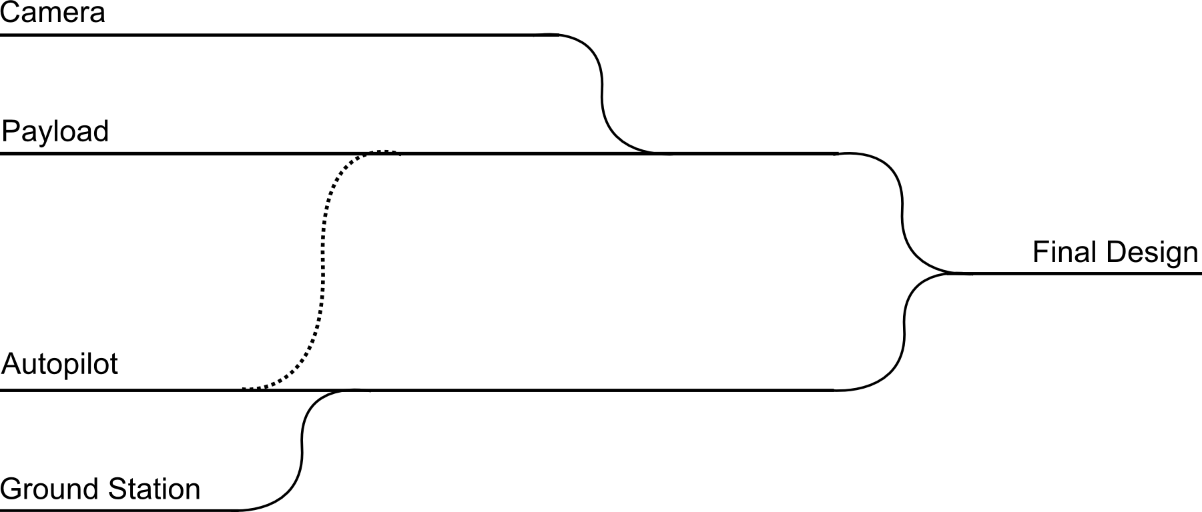
Streams
Acquired working camera
Got image off camera
Payload communicating with camera
Payload communicating with autopilot
Working GUI
Our software communicating with Autopilot via GS software
Autopilot debugging
PCB Implementation

Slide 47
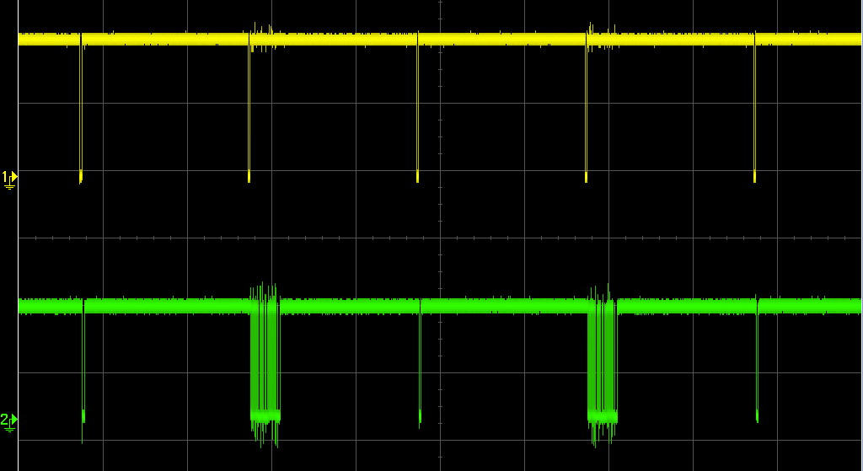
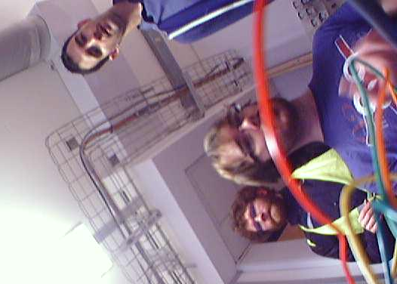
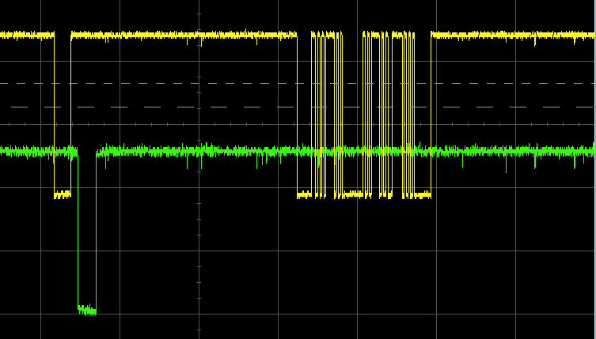
Testing
Tested system throughout and during integration phases

Slide 48
Demo

Slide 49
Extensions
Multiple cameras at once
Multiple types of camera
Video
SD filesystem access

Slide 50

Questions?

